Slide 1
Bike Course Information
2017

Slide 2
Basic Information
Be cautious
Be aware of debris on the roads
Crew—know your location—use your ticker
Err on the side of safety
Watch traffic
Be safe
Have fun!
Keep smiling!

Slide 3
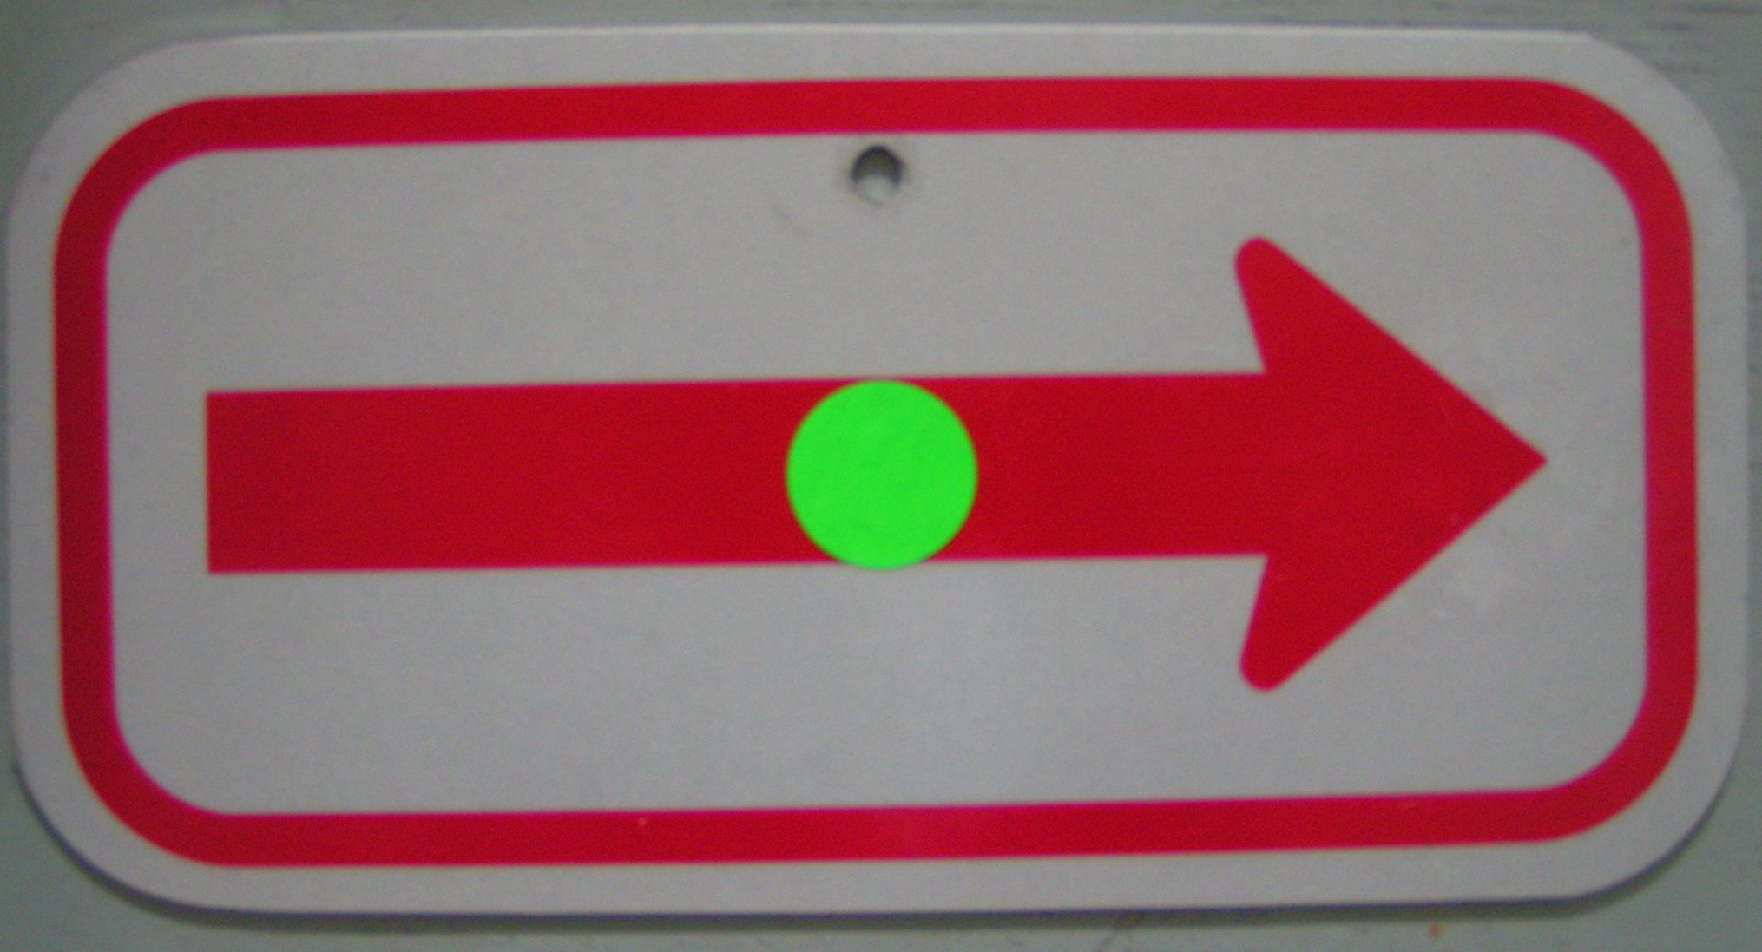
COURSE ARROWS

Slide 4
RIGHT Turn on to Alii Drive at FIRST intersection

Slide 5
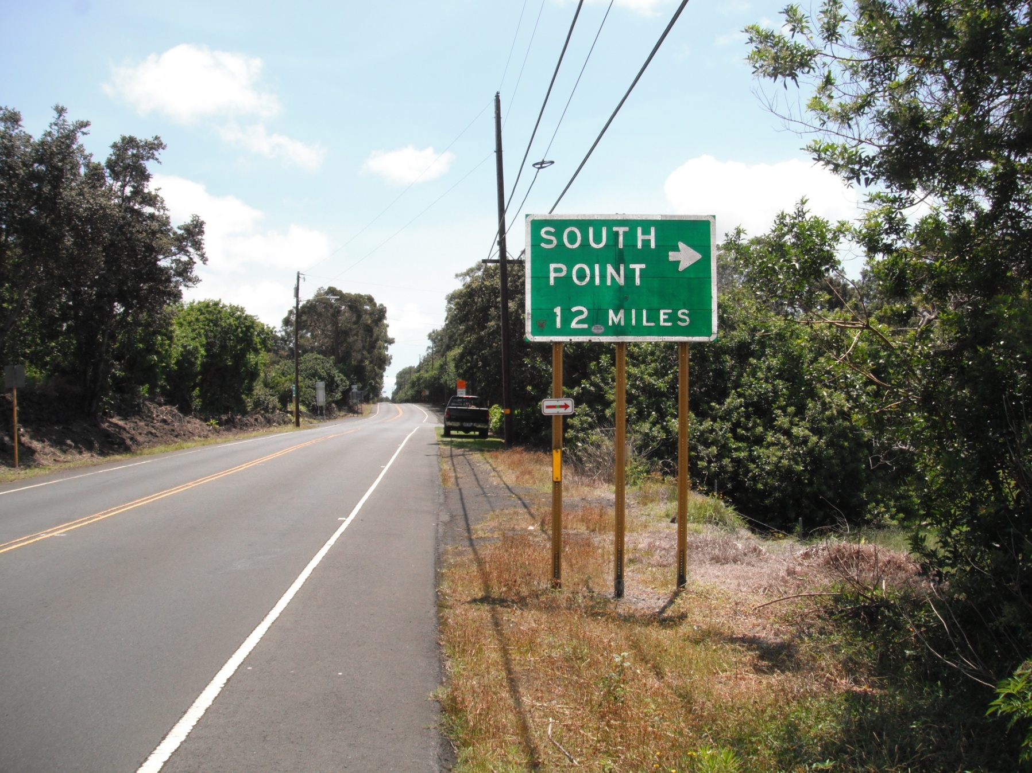
RIGHT TURN ONTO SOUTH POINT RD! __Miles
Aprx 0.9 miles past MM 70.

Slide 6
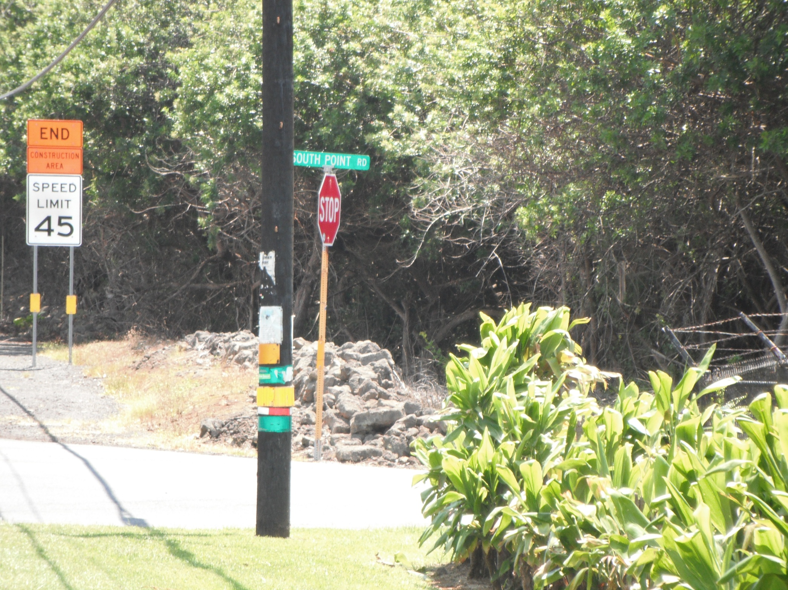

Slide 7
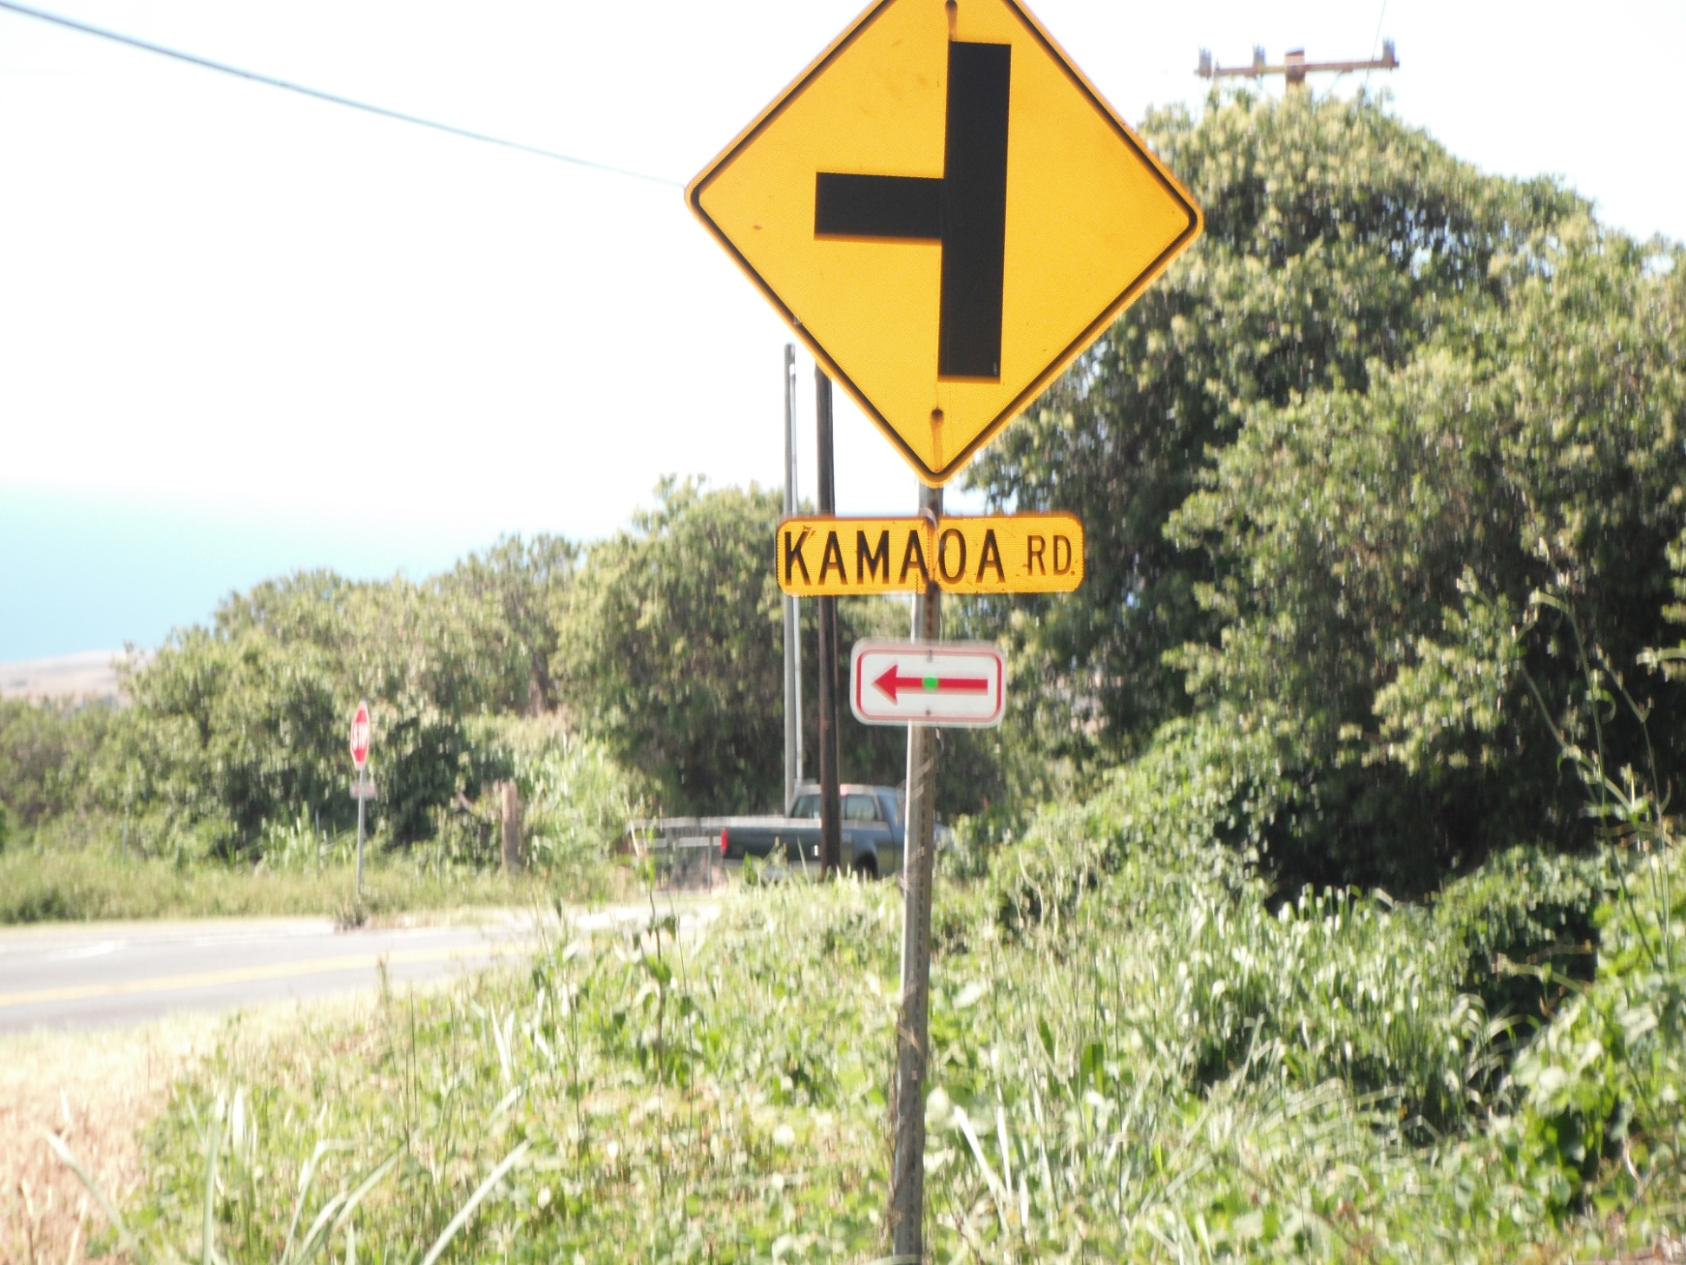
1.7 MILES TO SHARP LEFT TURN ONTO KAMAOA RD.

Slide 8
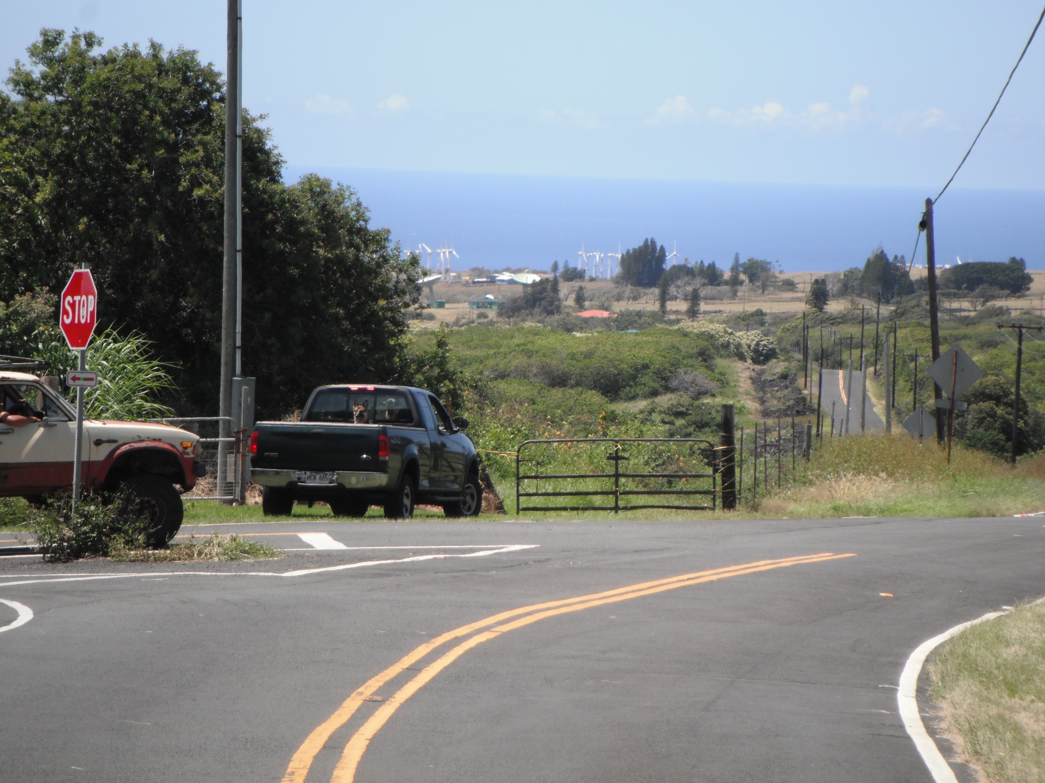

Slide 9
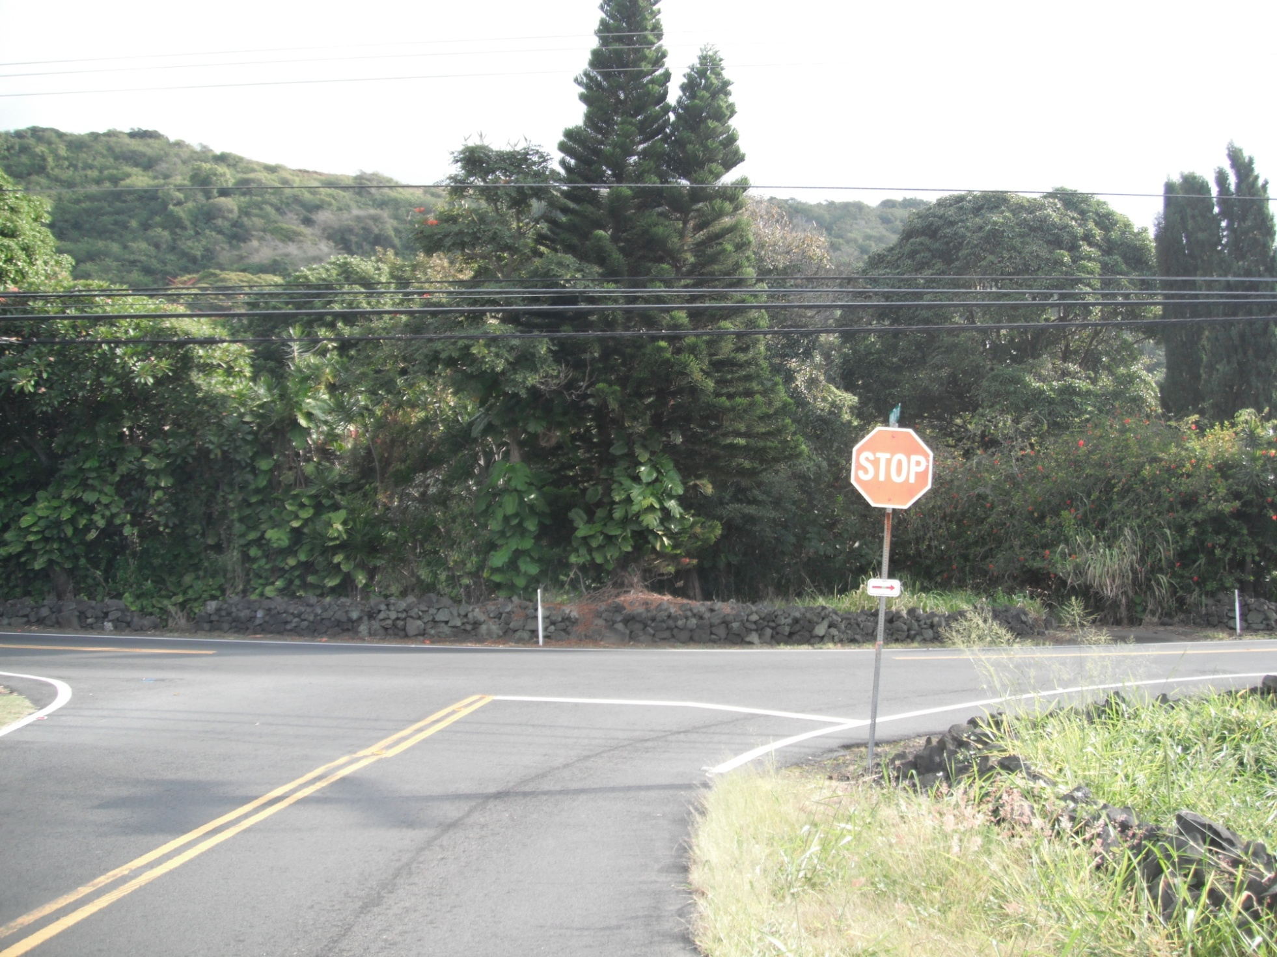
End of Kamaoa Rd.—Right turn back onto Hwy. 11

Slide 10
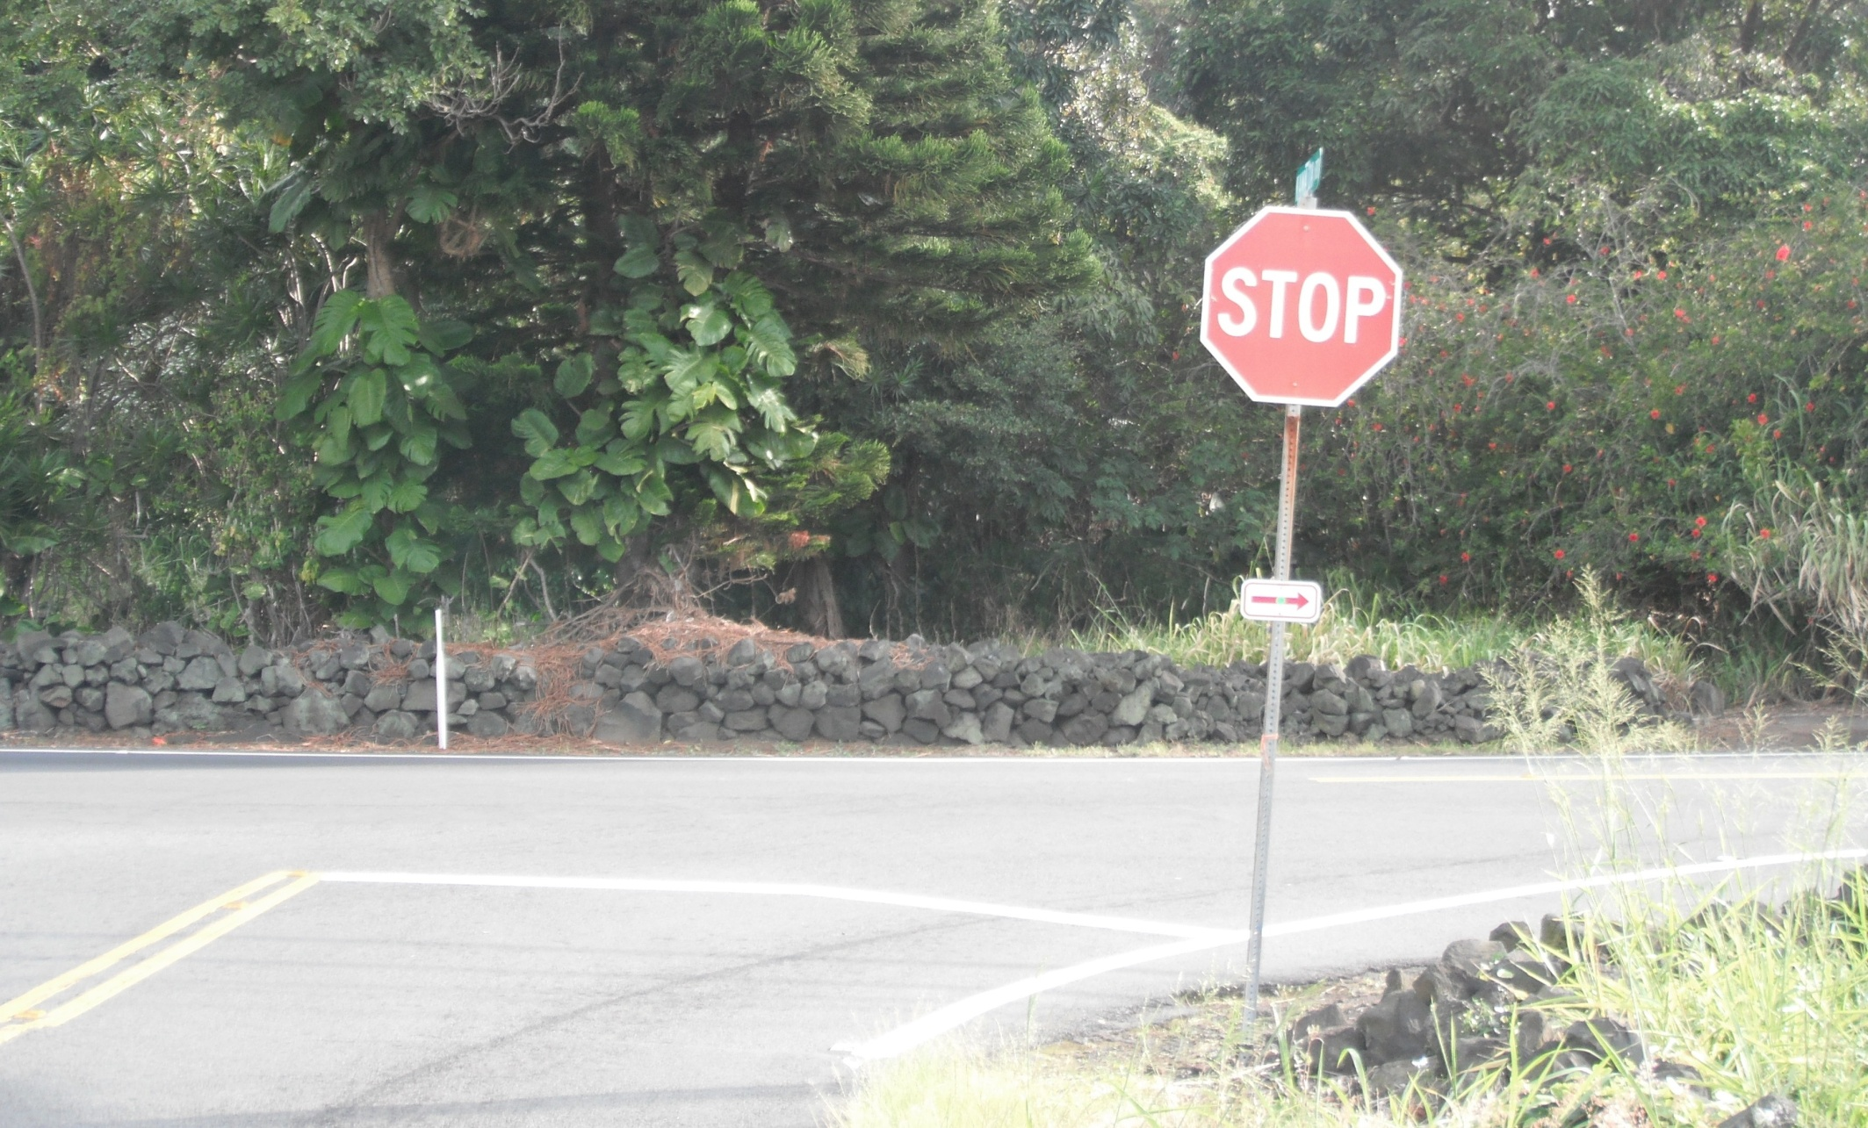
NOTICE: It is a stop sign! You must stop!

Slide 11
RIGHT turn to Punalu’u Black Sand Beach.

Slide 12
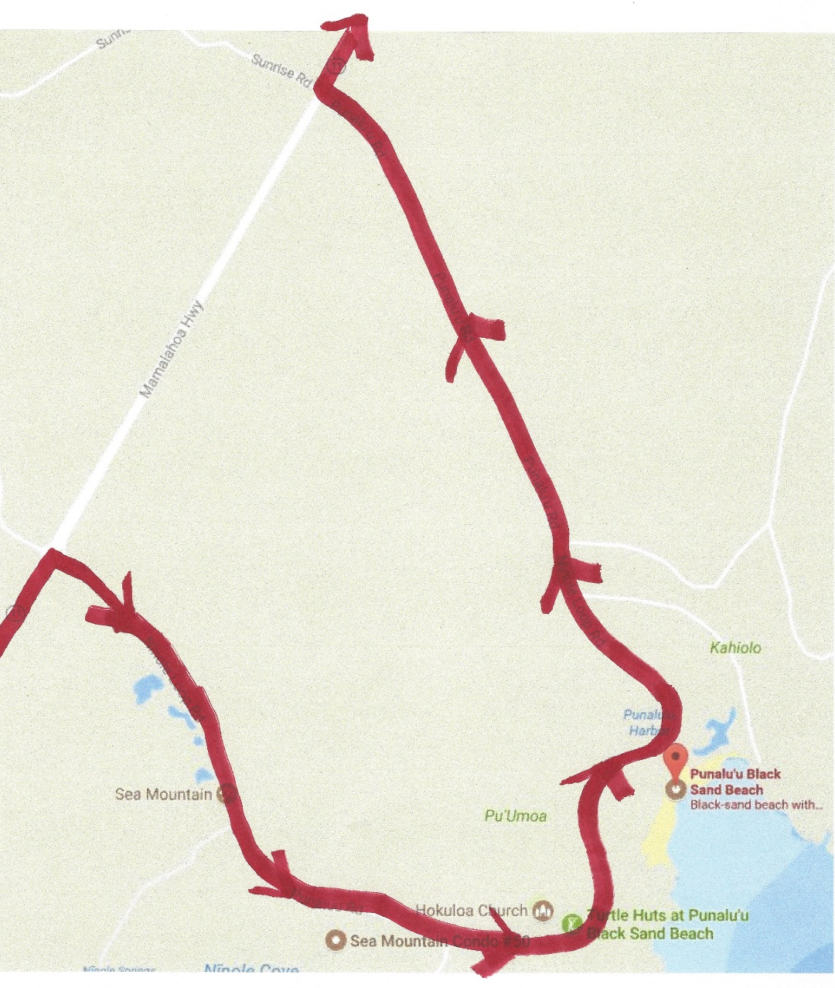
Punalu’u Loop-- Stay to left through the loop!!

Slide 13
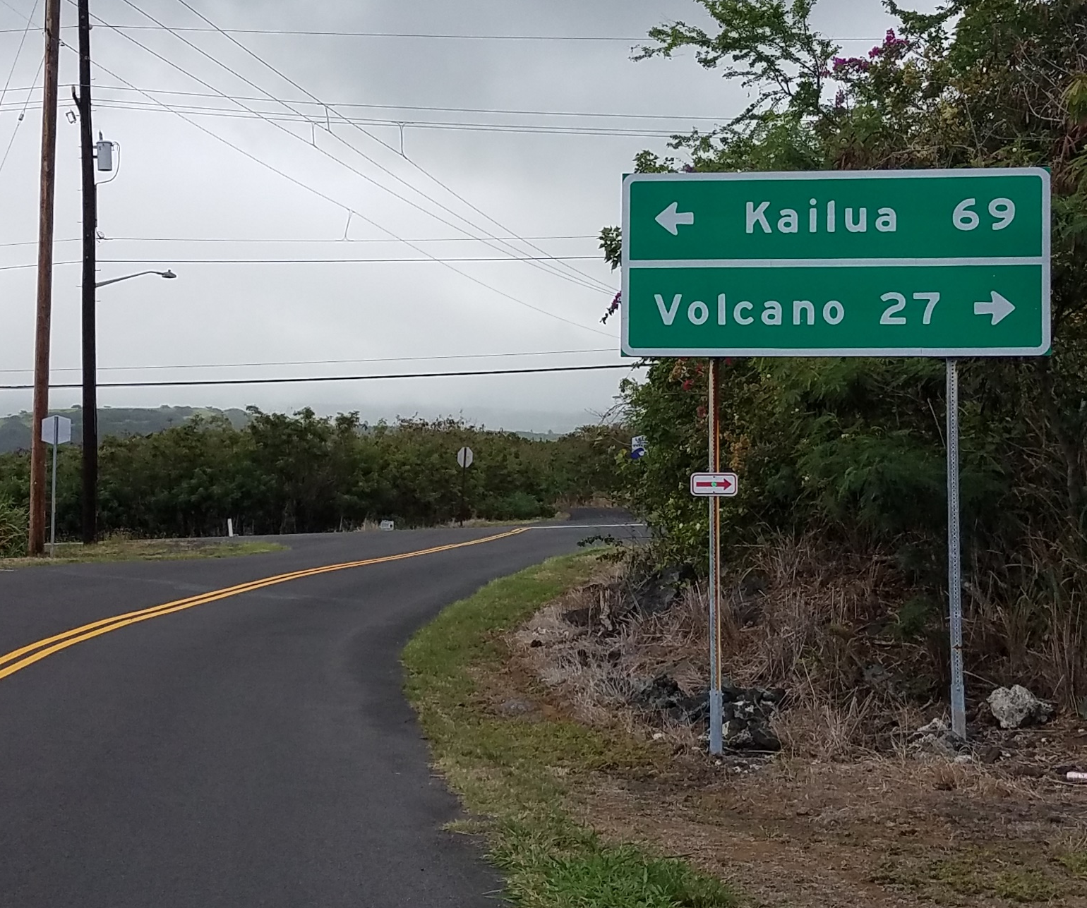
RIGHT turn back onto Hwy. 11

Slide 14
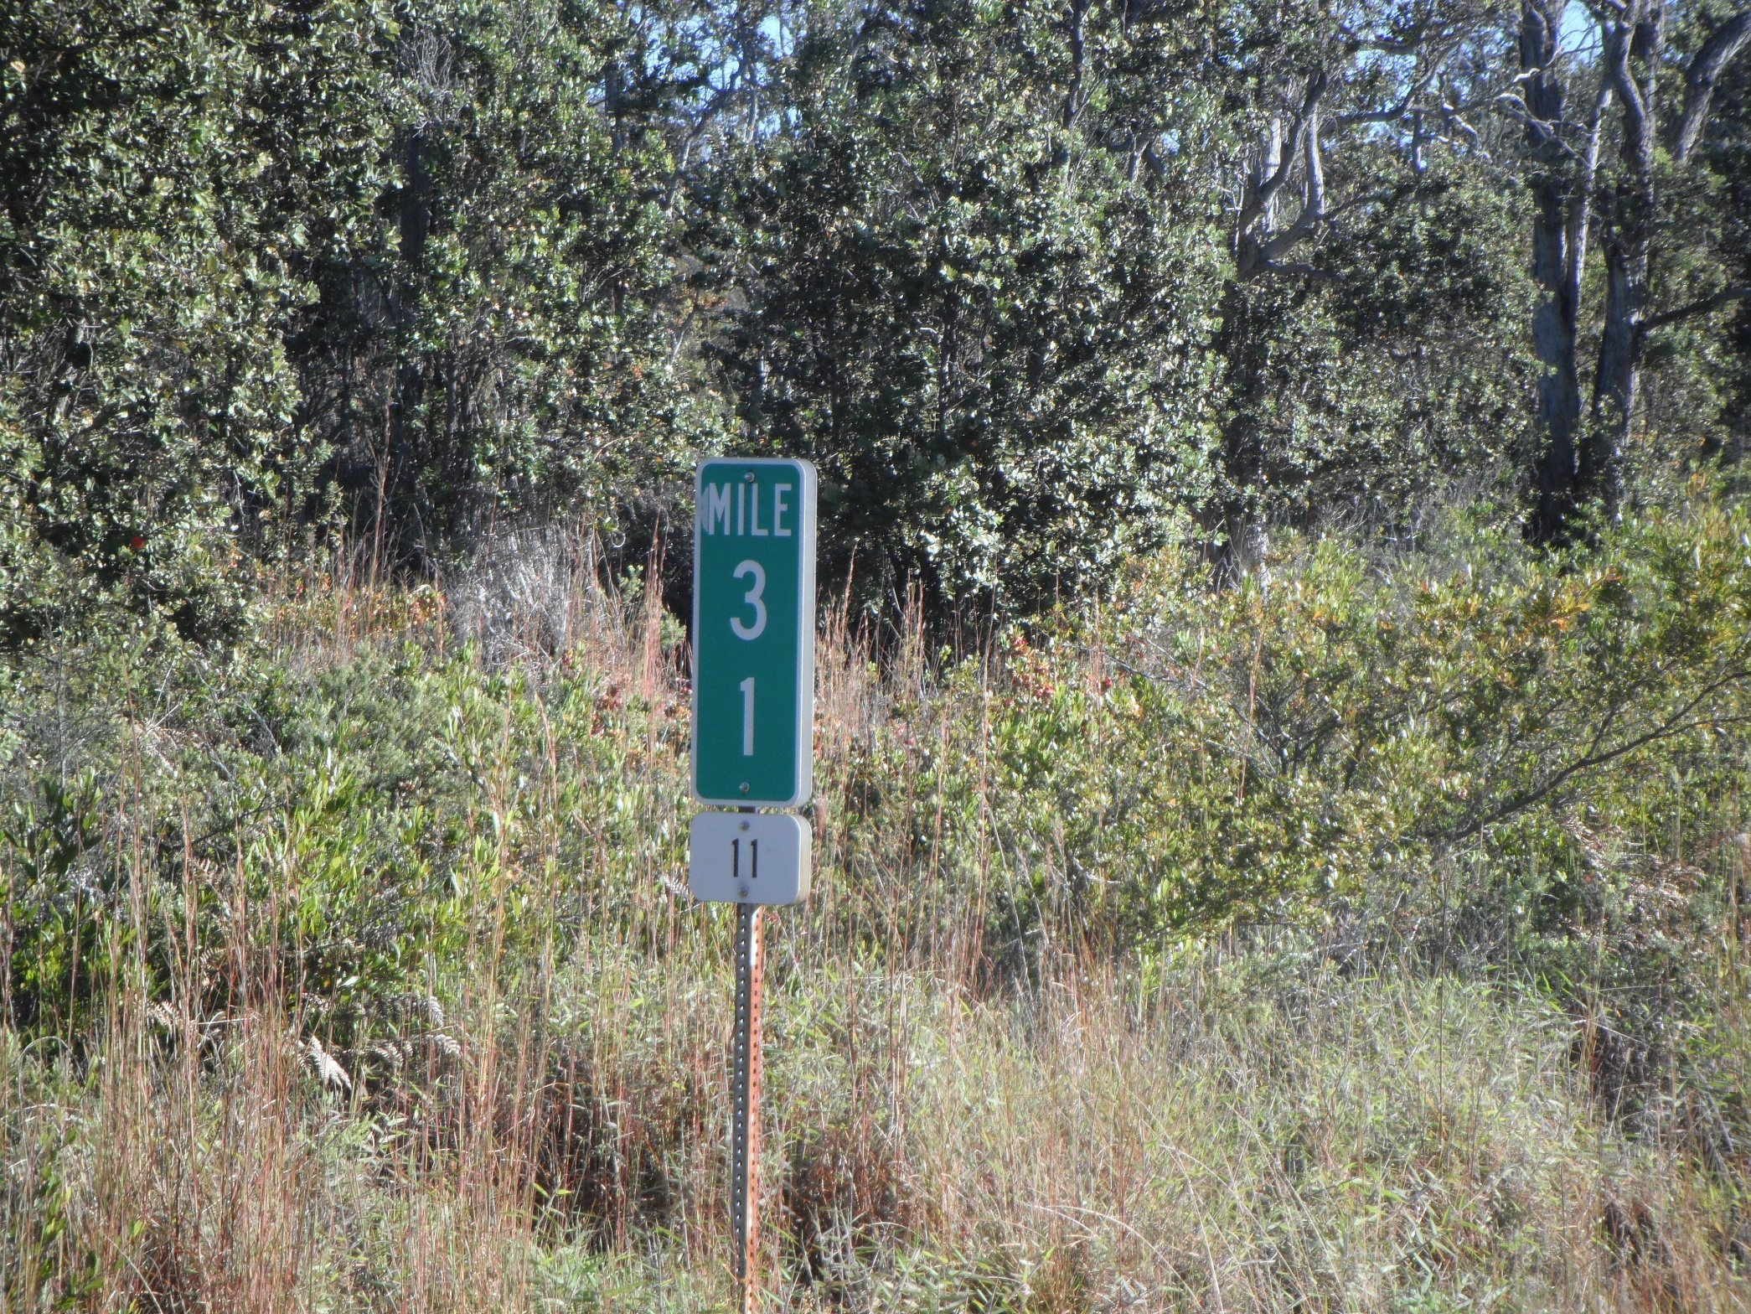
Mile Marker
Green indicates mile location
White indicates Hwy/Rd number
8/10 of a mile after this mile marker is the right turn to Day 1 finish line!

Slide 15
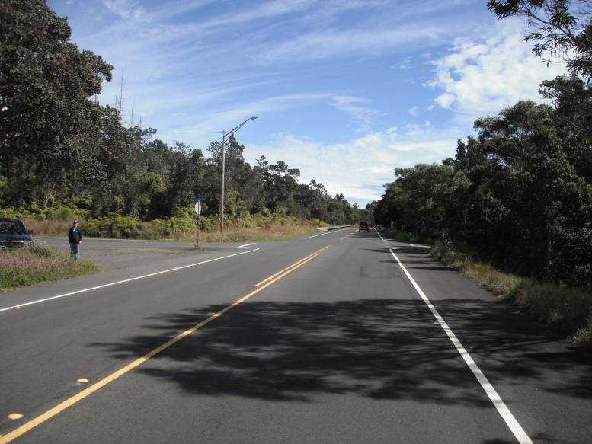
RIGHT TURN at Pi’i Mauna Dr.
No sign coming from Kona side…First right past Mauna Loa Rd.

Slide 16
Downhill to finish chute. Watch speed!

Slide 17
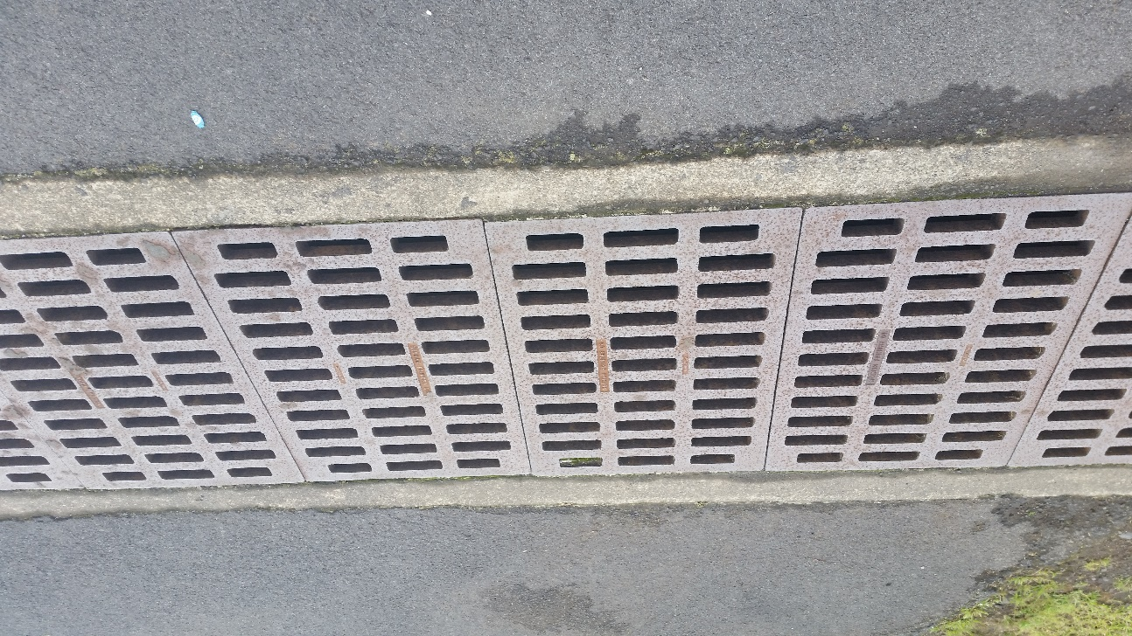
Metal grate after finish line. Slippery when wet. SLOW DOWN before approaching!

Slide 18
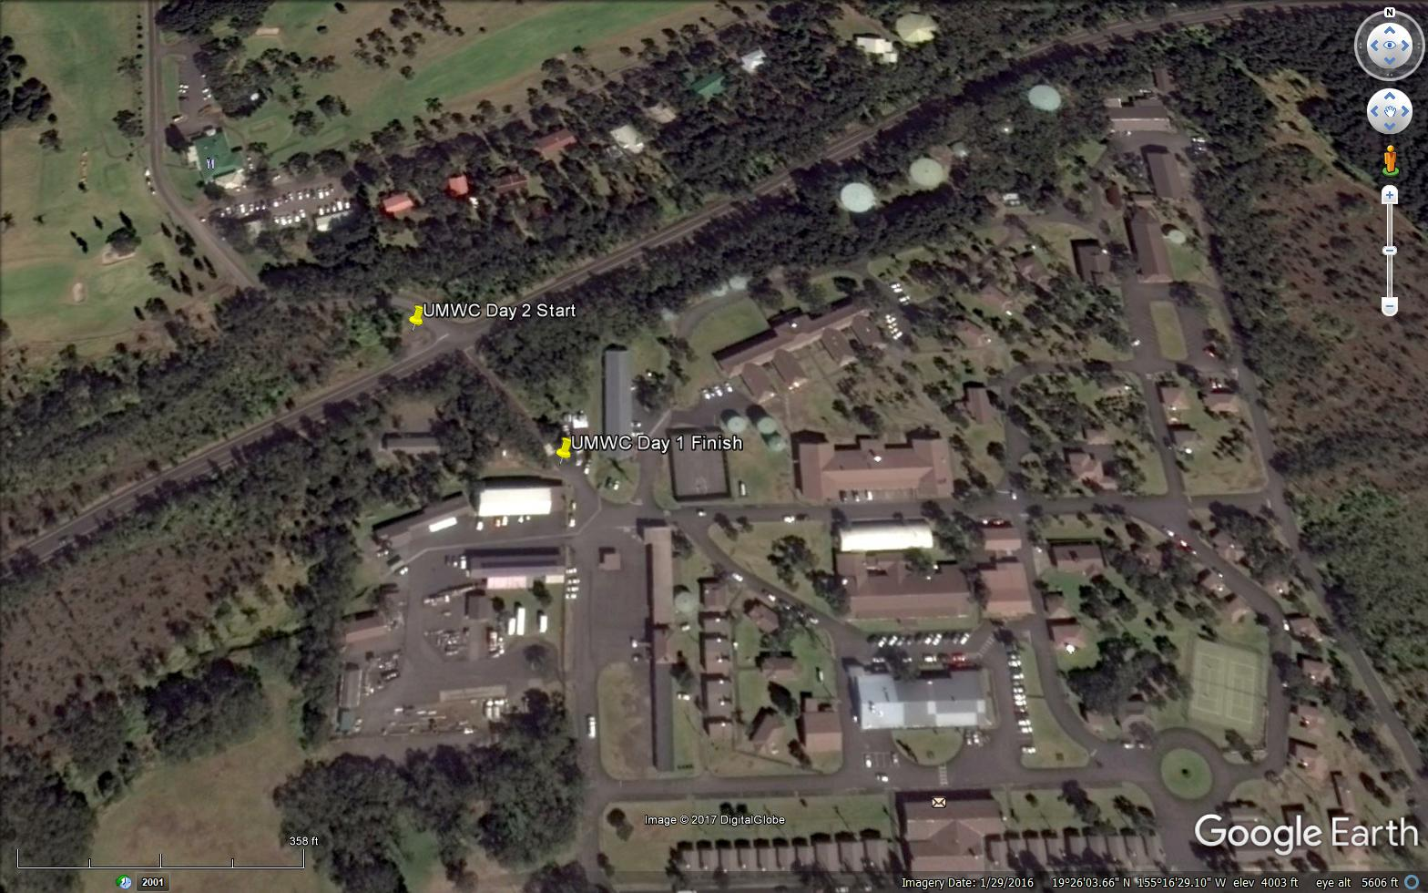
Google Earth View of the Day 1 Finish area, and Day 2 Start

